Slide 1
.
Employee Salary Data Analysis using Excel
Student Name : Nityashri Ramakrouchenane
Register No. : 122202490 , 0982DFD5FCA448F89F24A8F5F2B63DCE
Department : B.com Corporate Secretaryship
College : DR.MGR Janaki College Of Arts and Science For Women

Slide 2
Employee Salary Data Analysis using Excel Techniques

Slide 3
AGENDA
1. Problem Statement
2. Project Overview
3. End Users
4. Our Solution and Proposition
5. Dataset Description
6. Modelling Approach
7. Results and Discussion
8. Conclusion

Slide 4
PROBLEM STATEMENT
The problem of employee salary analysis involves understanding and addressing the disparities in compensation within an organization. It examines the effectiveness of current compensation strategies in retaining top talent and ensuring fair pay practices, which are critical for maintaining employee satisfaction and organizational success.

Slide 5
PROJECT OVERVIEW
The project involves collecting and analyzing salary data across various departments, roles, and employee demographics to identify trends, disparities, and potential areas of improvement. The ultimate goal is to promote equity, and enhance overall employee satisfaction and retention.

Slide 6
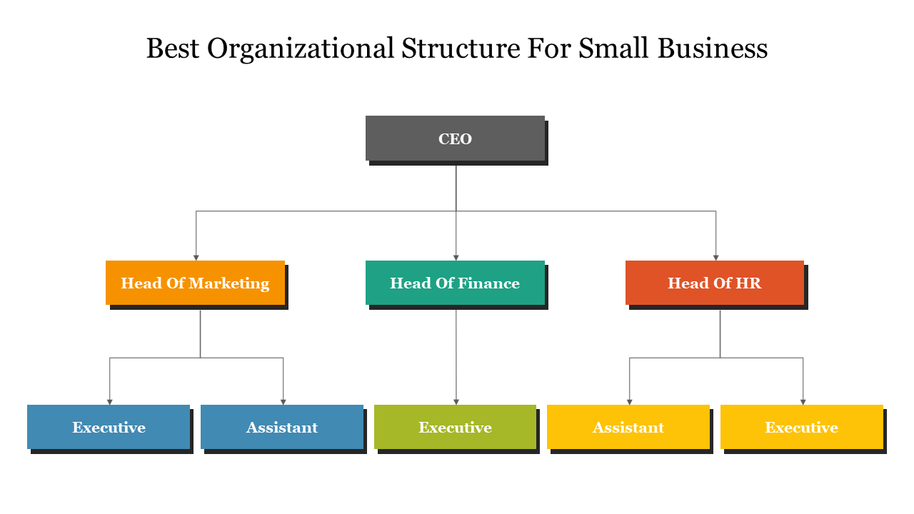
END USERS
The end users of the employee salary analysis project include HR professionals, managers, and executives within the organization. HR teams will use the insights to refine compensation policies and address any pay disparities. Managers can leverage the analysis to ensure equitable pay within their teams, aiding in performance reviews and promotion decisions.

Slide 7

Our Solution and Proposition
Conditional Formatting used for missing values.
Filtering used to remove the missing values.
Formula used for salary performance.
Pivot chart used for summarizing the data.
Graph used for Data representation.

Slide 8
Dataset Description
Employee Salary Data Set – Kaggle
10 Features that were considered in the data analysis are
Employee ID in numbers
Employee Name in text
Departments in text
Job title in text
Bonus in numbers
Years of experience in numbers
Joining date in numbers
Employee Rating in numbers
Salary in numbers
Salary level in numbers

Slide 9
‘The wow’ in our solution
Solution to this is using predictive models forecast future salary distributions, helping with better decision-making. With easy-to-use dashboards and customizable reporting this transforms complex data into simpler ones using formula, ensuring equitable pay that drives towards organizational success.
The formula that was used in this analysis -
Salary level - =IFS(I2>=80000," high",I2>=50000,"med",I2>=30000,"low",TRUE,"low")

Slide 10
MODELLING APPROACH
Data collection-
Downloaded Salary data sheet from Kaggle.
Feature collection-
Employee ID.
Departments.
Salary level.
Employee rating.
Data cleaning-
Identification of missing values.
Filtering out the missing value.

Slide 11
Performance level-
Performance was calculated using Salary level of the employees.
Summary-
Using pivot table the data that was collected was used to create a pivot table with all the features that were collected.
Job title and employee ratings were placed in filter section so that detailed information can be extracted according to the criteria stated.
Columns consists of salary level of employees and rows consists of the departments they work under.
Employee ratings were placed under values.
Visualisation-
Pie chart used for representation of the pivot table that was created.

Slide 12
Results and Discussion

Slide 13
Conclusion:
The largest portion of the chart (1038) is in the pink section, representing the "Sales" department.
The next largest segment is in red (447), representing the "Finance" department.
"IT" is also a considerable segment (421), followed by "Engineering" (326).
The smallest segments are "Admin" (266), "HR" (274), and "Marketing" (291).
The chart indicates that the Sales department is the most dominant in terms of salary distribution, followed by Finance and IT. In contrast, Admin, HR, and Marketing have smaller shares of the overall salary distribution. This also indicates that the company might prioritize investment in Sales, Finance, and IT departments due to their critical roles in the company's operations or revenue generation.

